Slide 1
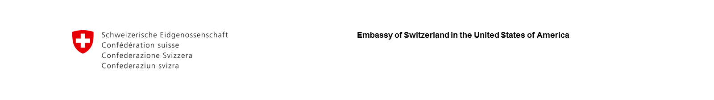

Reach Higher Convening, March 6, 2017
Tracy Dove, Ph.D
Scientific Advisor, Embassy of Switzerland
Sustainability in the Face of Change:
Swiss-Style Apprenticeships in the USA
@Martin_Dahinden
@SwissEmbassyUSA

Slide 2
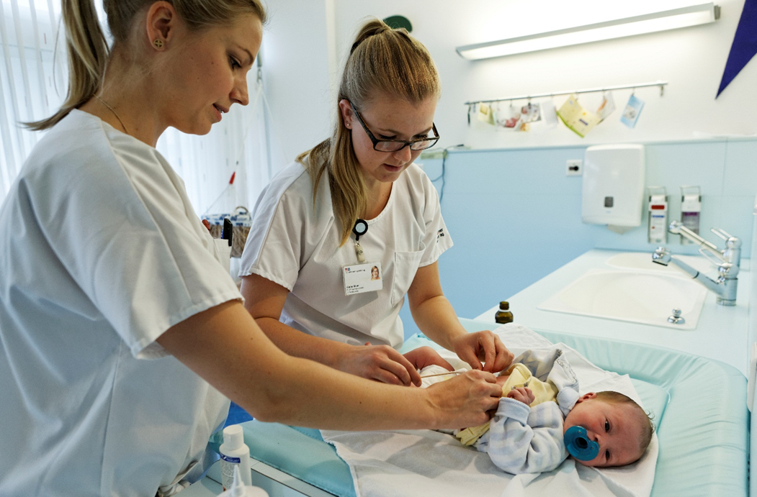
The Swiss Apprenticeship Model

Slide 3
Features of Swiss apprenticeship system
Public-private partnership
Integrated into education system: Permeability
Labour market orientation

Slide 4
Public-private partnership:
1 mission – 3 partners
Cantons
Vocational Schools and supervision
Confederation
Strategic management and development
Private sector
Apprenticeship positions and training content

Slide 5
Funding of apprenticeship system

Slide 6
Cost/benefit ratio for Swiss companies offering apprenticeships in CHF million

Slide 7

The Apprenticeship as a first step into the labour market and lifelong learning
Cantonal universities /
federal institutes of technology
(Federal vocational Baccalaureate + University Aptitude Test)
Labour Market
Universities of applied sciences (UAS)
(Federal vocational Baccalaureate)
Job-related continuing education and training
Professional education and training (PET)
Apprenticeship (Reorientation, further qualifications)
Apprenticeship

Slide 8


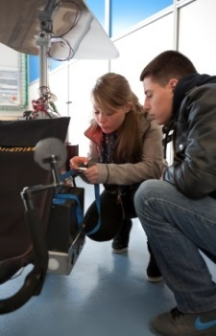

A comprehensive and labor market oriented educational pathway
2-year Federal Certificate
3-year or 4-year Federal Diploma
Federal Vocational Baccalaureate (FVB)
Practice
Theory
3-4 days per week of
in-company training
and industry courses
1-2 days per week of classroom instruction at Vocational School (FVB is optional)

Slide 9
Labour market oriented →
High employability
Source: Swiss Federal Statistical Office (FSO) / Swiss Labour Force Survey (SLFS);
Estimates by Federal Department of Economic Affairs, Education and Research (EAER)

Slide 10
Outcomes of Swiss apprenticeship system
Labour market orientation
Skill mix
Quality
Permeability
Portability
Cost efficiency

