Slide 1
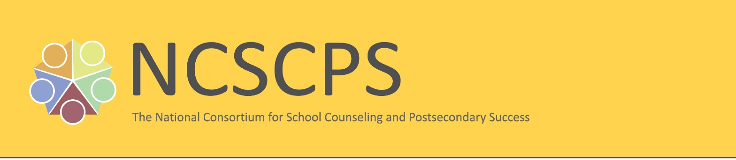
REACH HIGHER CONVENING
Arizona State University
March 6, 2017
Historical Perspective

Slide 2
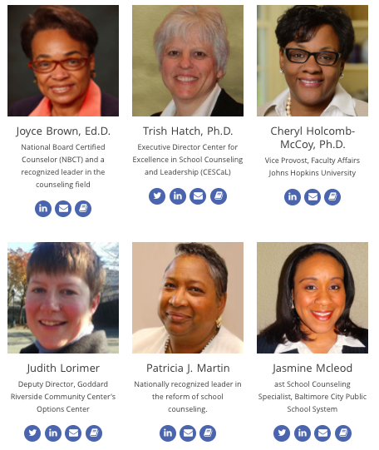
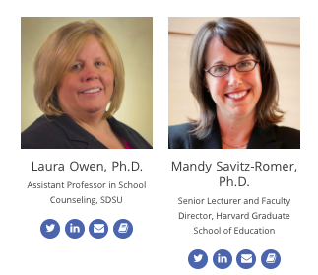
Our consortium emerged in response to First Lady Michelle Obama's Reach Higher initiative and the call for improvements to school counseling and school-based college and career counseling systems.
We promote strategic partnerships with state leadership organizations to ensure that school counselor standards and guidelines ensure postsecondary success for underserved and/or first generation college students.
9/21/2015
Notes:
Before we continue… please allow us to introduce ourselves and a new organization that is focused on a collaborative model of SC and postsecondary success.

Slide 3
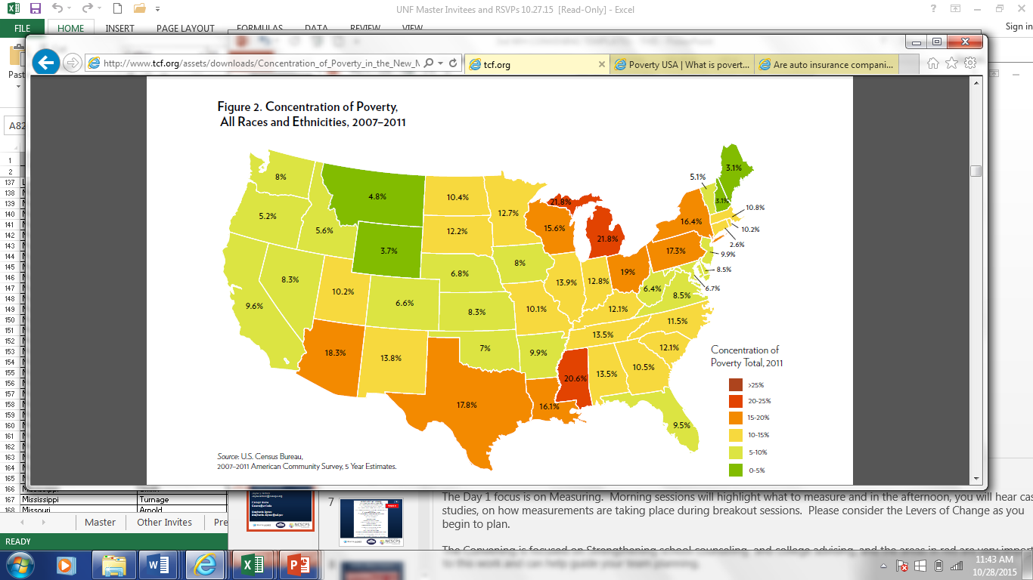
STUDENTS IN POVERTY
25% | 20 – 25% | 15 – 20% | 10 – 15% | 5 – 10% | 0 – 5%
What Color Is Your State?

Slide 4
NCSCPS Conceptual Framework
FIVE KEY AREAS OF ACTION
CCR STANDARDS AND CREDENTIALING
POLICY
RESEARCH
PRE-SERVICE AND INSERVICE TRAINING
PRACTICE
STUDENT OUTCOMES

Slide 5
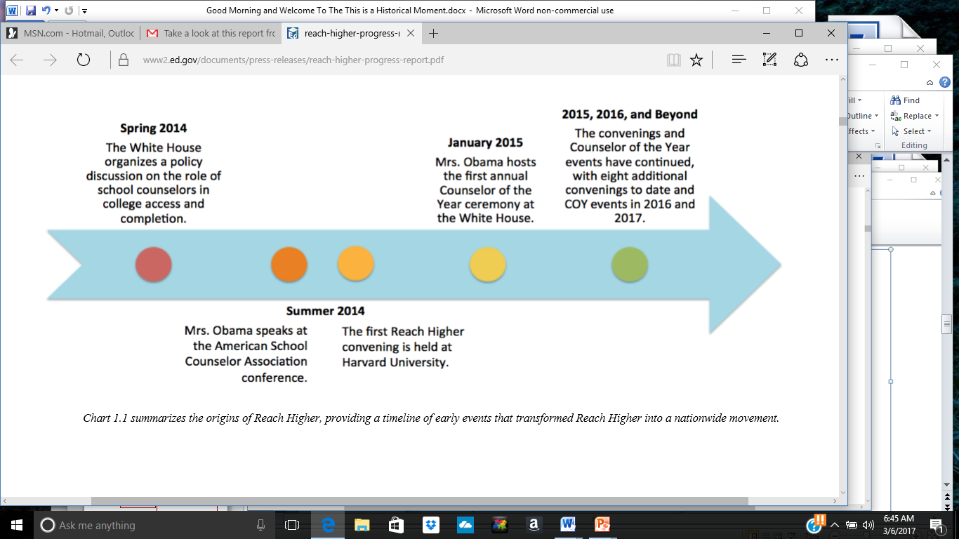
REFLECTION – How The Work Began

Slide 6
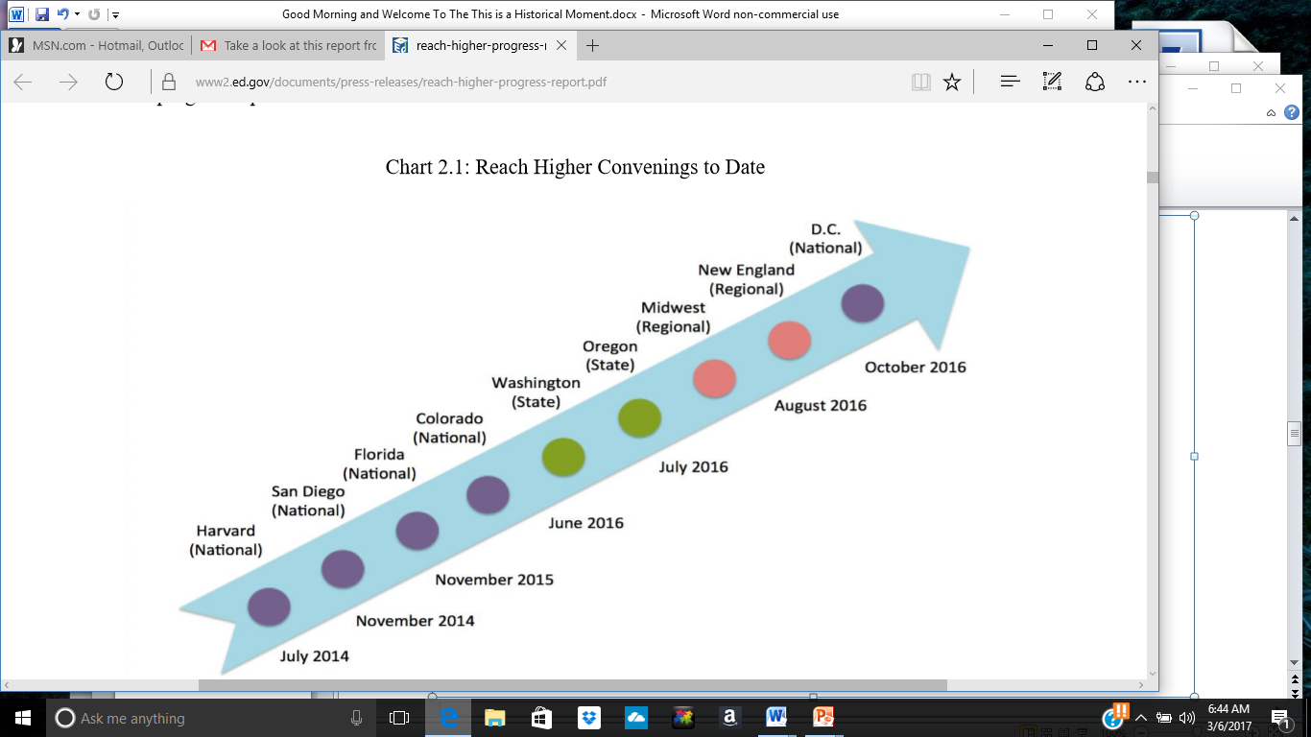
6 National REACH HIGHER Convenings
4 Regional REACH HIGHER Convenings

Slide 7
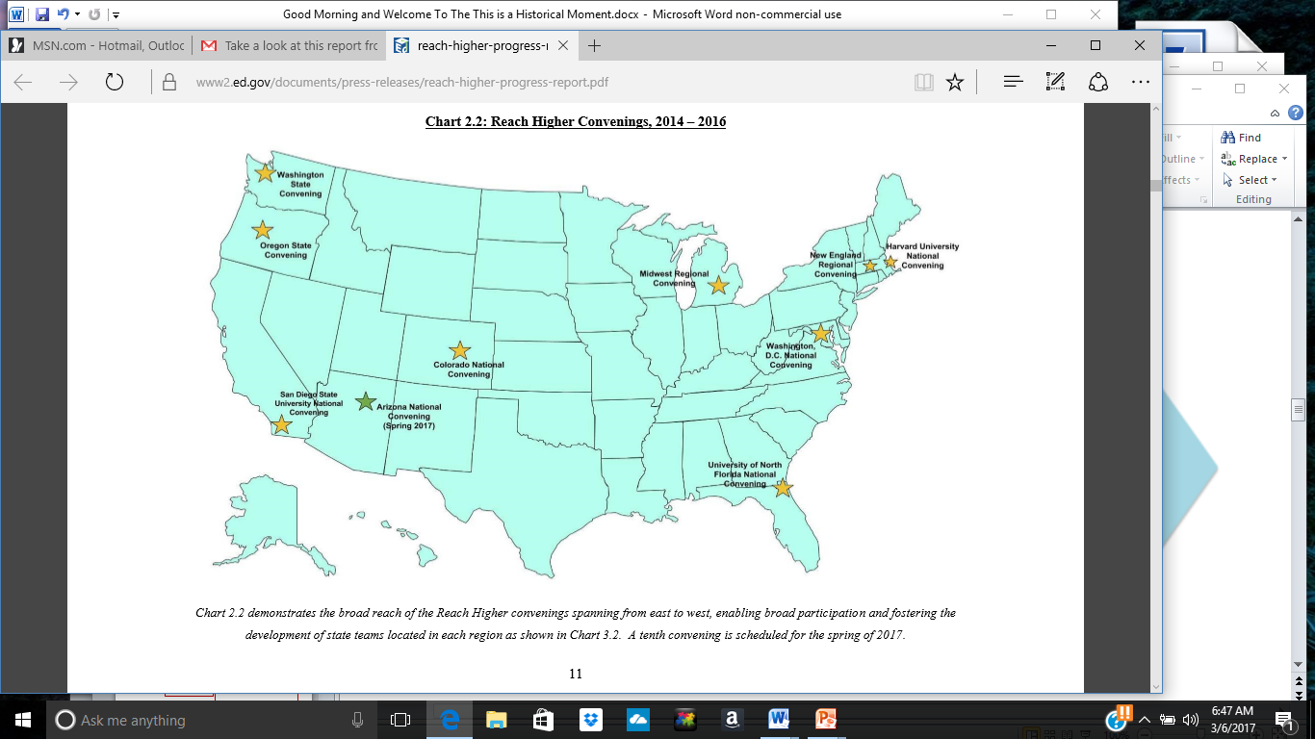
Is Your State Next?

Slide 8
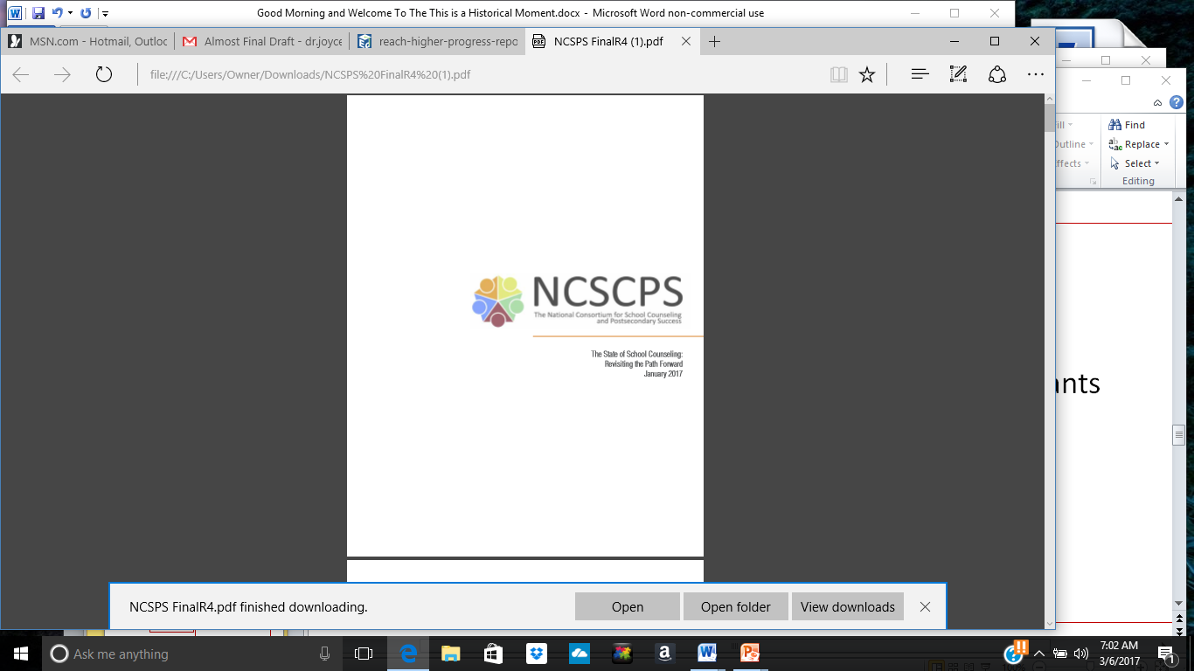
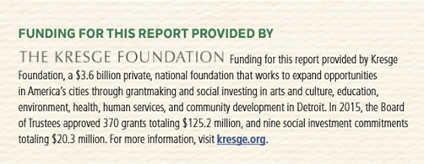
NCSCPS - Incredibly Thankful!
Lit Review
Survey Participants
Think Tank Participants
State Teams

Slide 9
THE WAY FORWARD………………….
Sustainability Action Plans

